Slide 1


GRADE 8 ICT/DESIGN
Lesson 2: Plotting Shapes (Code.org 3b)
Ms. Abboud • Grade 8 - ICT/Design • Term 1, Week 8

Slide 2
Learning Objectives
WALT - We Are Learning To
WILF - What I'm Looking For
Describe where shapes go using the Game Lab coordinate grid.
I can find a point on the grid from its x and y values.
My instructions include position, size, color and order.

Slide 3
Academic Vocabulary
Coordinate
Coordinate Grid
A pair of numbers (x, y) that gives an exact position on the screen.
The grid of x and y positions used to place things on the Game Lab screen (400 by 400).

Slide 4
Frayer Model: Coordinate
DEFINITION
CHARACTERISTICS
A pair of numbers (x, y) that gives an exact position on the screen.
x goes across, y goes down; (0, 0) is the top-left corner of Game Lab.
COORDINATE
EXAMPLES
NON-EXAMPLES
(200, 200) is the middle of the 400 by 400 Game Lab screen.
'Put it somewhere near the top' (not exact).

Slide 5
National Identity Integration
UAE heritage of geometric design: the patterns in mosques and traditional buildings across the UAE rely on exact shapes and positions. A computer needs the same precision to draw.

Slide 6
STARTER
Draw What I Say
One partner describes a simple drawing, the other draws it without looking.
What made it hard to get right?
Hook • Engage & Ask
5 - 10 minutes

Slide 7
LESSON CORE
I Do: The Coordinate Grid
The Game Lab screen is 400 by 400.
x goes across, y goes down, and (0, 0) is the top-left corner.
A computer needs position, size, color and order for every shape.
Gradual Release of Responsibility
35 - 45 minutes
1 / 3

Slide 8
LESSON CORE
We Do: Plot Together
Find (200, 200), (50, 350) and (350, 50) on the grid together.
Describe one shape as a class: 'A red circle at x 100, y 100, width 50.'
Gradual Release of Responsibility
35 - 45 minutes
2 / 3

Slide 9
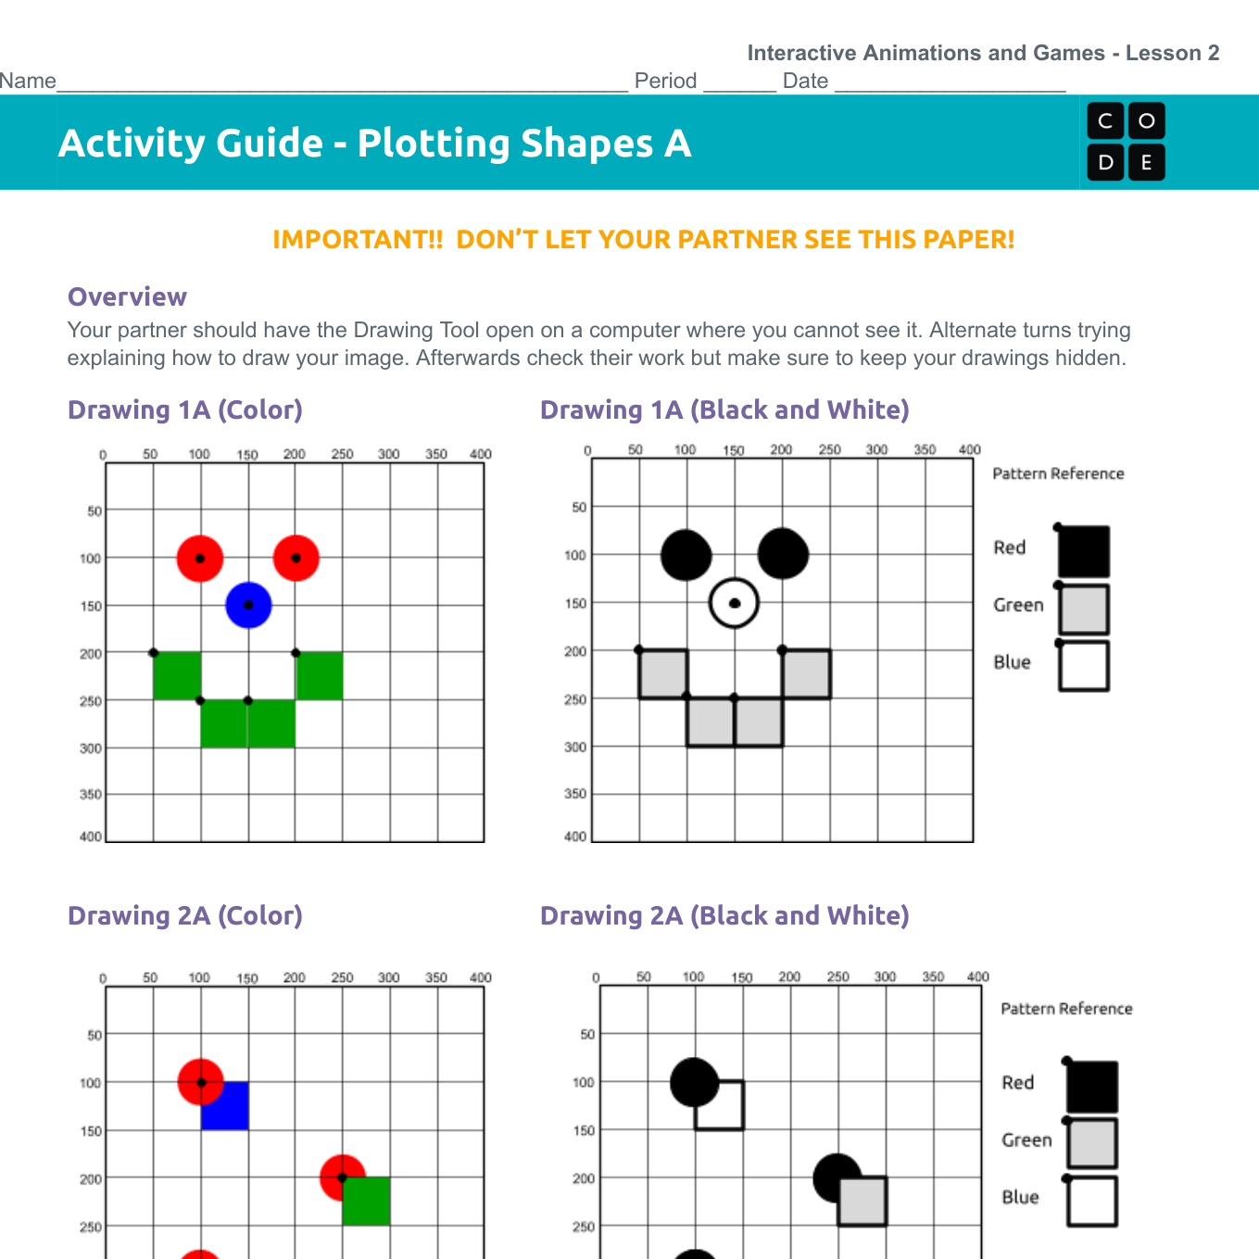
LESSON CORE
You Do: Drawing Shapes
With a partner: one describes, one draws, then swap Version A and B.
Compare drawings: what made your instructions clear?
Code.org activity: Drawing Shapes
Gradual Release of Responsibility
35 - 45 minutes
3 / 3

Slide 10
CLOSURE
Exit Ticket
Where is the point (200, 200) on the Game Lab grid?
Transition & Extend
5 - 10 minutes

